Slide 1
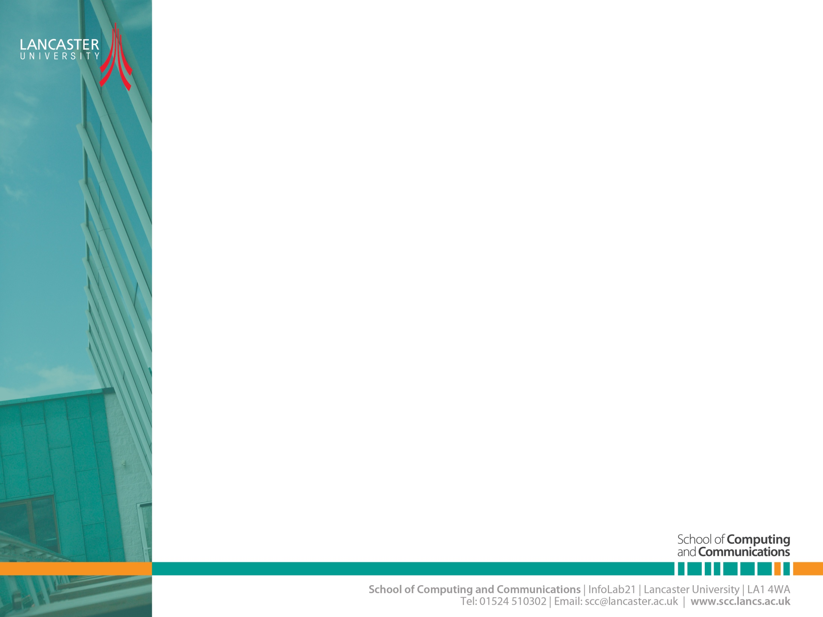

Introduction to OFDM
CNSCC.405
Digital Signal Processing
Dr Muhammad Abrar (Dr. MAB)
m.abrar@lancaster.ac.uk

Slide 2

🎯 Learning Outcomes
By the end of this lecture, students should be able to:
Explain
Explain the difference between single-carrier and multicarrier modulation
Understand
Understand why OFDM solves ISI problems in frequency-selective channels
Describe
Describe how orthogonality allows overlapping subcarriers
Explain
Explain the role of the cyclic prefix and how to size it
Perform
Perform basic OFDM parameter calculations (subcarrier spacing, symbol time, CP overhead, data rate)

Slide 3
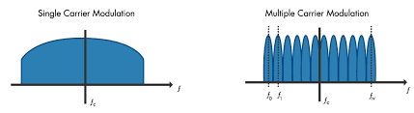
Single Carrier vs Multicarrier Modulation
SCM uses a single carrier frequency to transmit the entire data, whereas MCM divides the data into multiple subcarriers, each with its own carrier frequency, and transmits them simultaneously.
SCM may be simpler in terms of hardware requirements, but it may be less spectrum efficient and more susceptible to channel impairments.
On the other hand, MCM may be more complex in terms of hardware, but it can achieve higher spectral efficiency and may be more robust to channel impairments.

Slide 4
Single-carrier baseband Communication System Model.
Limitation of Single Carrier Modulation
Spectral Efficiency:
Frequency Selective Fading:
Interference

Slide 5
Multicarrier Modulation
As the name implies, if the data stream modulates a single carrier wave, we refer to this process as single carrier modulation. So far, we have only focused on single carrier modulation schemes.
However, if the data stream is divided into multiple sub-streams, each of which modulates a different carrier wave, we call this approach multicarrier modulation.
Multicarrier modulation effectively splits a broadband channel into multiple narrowband channels, which do not have to occupy a contiguous block of spectrum.
Narrowband channels experience relatively flat fading and, thus, do not suffer much from intersymbol interference.
Orthogonal Frequency Division Multiplexing (OFDM) is a digital implementation of multicarrier modulation.

Slide 6
Example
Transmit Data: 11001100
SCM: ?
The entire modulated waveform is transmitted over the communication channel as a single continuous waveform.
MCM: ?
In MCM, the binary data "11001100" would be divided into multiple subcarriers, each with its own carrier frequency, and the data would be transmitted simultaneously on these subcarriers.

Slide 7
Multicarrier Transmission
Fig: Basic structure of multicarrier system
Fig: Spectral characteristic of multicarrier system

Slide 8
Single Carrier vs Multicarrier
Feature | Single Carrier (SCM) | Multicarrier (MCM / OFDM)
Carrier frequency | One | Many (parallel subcarriers)
Symbol duration | Short | Long (per subcarrier)
ISI sensitivity | High | Low
Equalization | Complicated | Simple (1-tap per subcarrier)
Spectrum | Wide waveform | Many narrowband tones
Complexity | Lower TX, harder RX | FFT-based, balanced

Slide 10
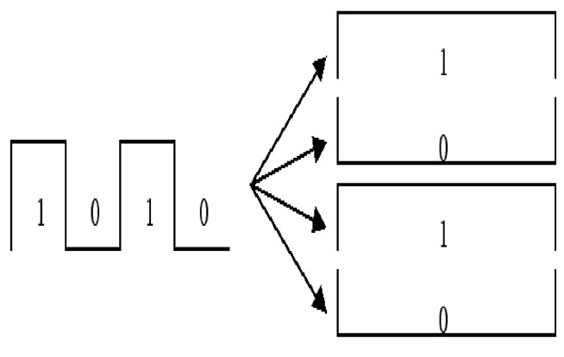
Traditional vs OFDM

Slide 11
OFDM Concept
The fundamental principle of the OFDM system is to decompose the high-rate data stream (bandwidth = W ) into N lower rate data streams and then to transmit them simultaneously over a large number of subcarriers.
A sufficiently high value of N makes the individual bandwidth (W/N ) of subcarriers narrower than the coherence bandwidth (Bc ) of the channel.
The choice of individual subcarrier is such that they are orthogonal to each other, which allows for the overlapping of subcarriers because the orthogonality ensures the separation of subcarriers at the receiver end.
This approach results in a better spectral efficiency than that of FDMA systems, where no spectral overlap of carriers is allowed.

Slide 12
OFDM Transmission Scheme

Slide 13
Spectra of OFDM individual subcarrier.

Slide 14
Spectra of OFDM symbol.

Slide 15
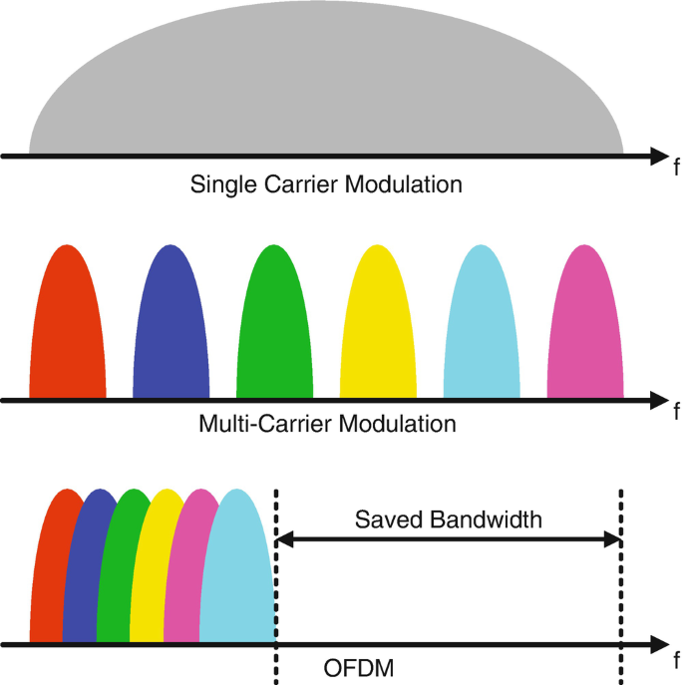

Slide 16
OFDM Implementation
Multicarrier modulation was invented in the 1950s but the use of separate modulators and demodulators was far too complex for most systems at the time.
Twenty years later, cheap implementations of the discrete Fourier transform (DFT) and the inverse DFT as well as the realisation that multicarrier modulation could be implemented using these algorithms, ignited interest and led to the invention of OFDM.
Orthogonal Frequency Division Multiplexing (also known as DMT: discrete multi-tone in DSL systems) improves spectral efficiency of multicarrier modulation by allowing the N sub-channels to overlap.
The selected subcarriers need to form a set of orthogonal functions; when this is achieved, the N signals transmitted on each sub-channel can be separated out at the receiver.

Slide 17
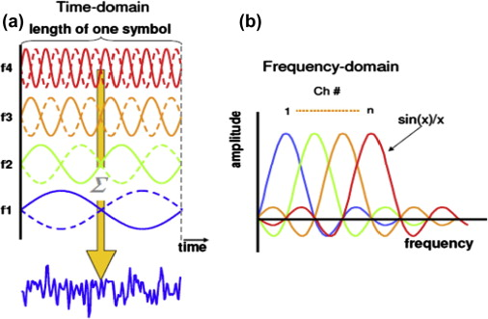
OFDM Time vs Frequency Domain

Slide 18
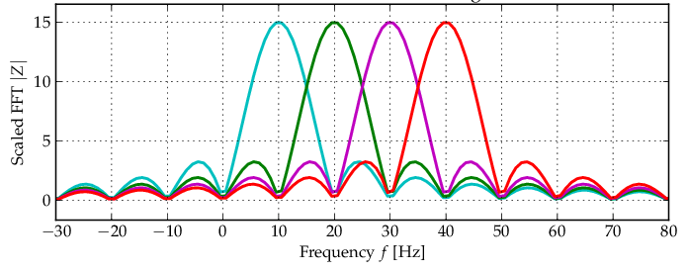
Orthogonal Sub-Carrier
Orthogonal means that the subcarriers are mutually perpendicular or do not interfere with each other
Notes:
Orthogonal Sub-Carrier refers to a technique used in Multicarrier Modulation (MCM) where the subcarriers used for transmitting data are orthogonal to each other. Orthogonal means that the subcarriers are mutually perpendicular or do not interfere with each other, allowing for efficient transmission of multiple subcarriers without interference. This technique is commonly used in Orthogonal Frequency Division Multiplexing (OFDM), which is a widely used MCM scheme in modern communication systems such as Wi-Fi, LTE, and 5G.

Slide 19
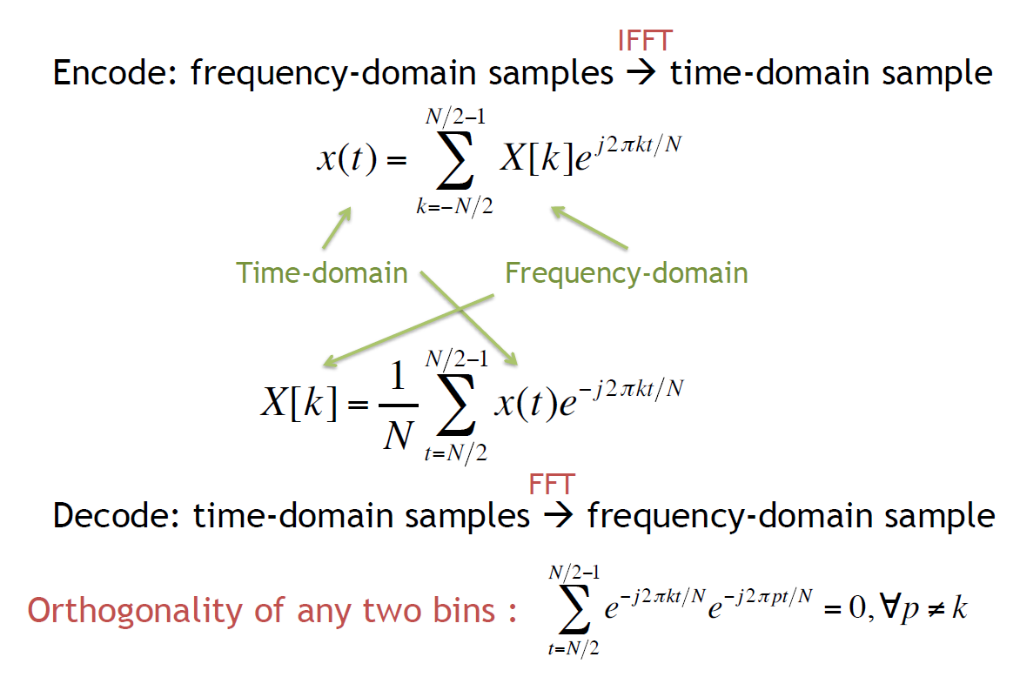
Orthogonality of Sub-carriers

Slide 20






Why OFDM is better?
t
t
₀ 0
1
f
₁ 0
₀ 1
f
0 1 1 0 0
₀ ₁ …........
Wide‐band Narrow­‐band
Multiple sub-channels (sub-carriers) carry samples sent at a lower rate
 Almost same bandwidth with wide-band channel
Only some of the sub-channels are affected by interferers or multi-path effect

Slide 21
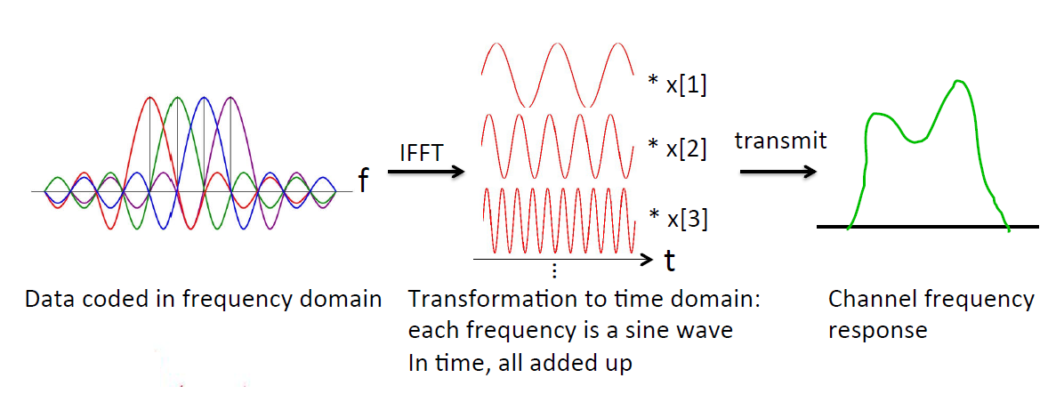
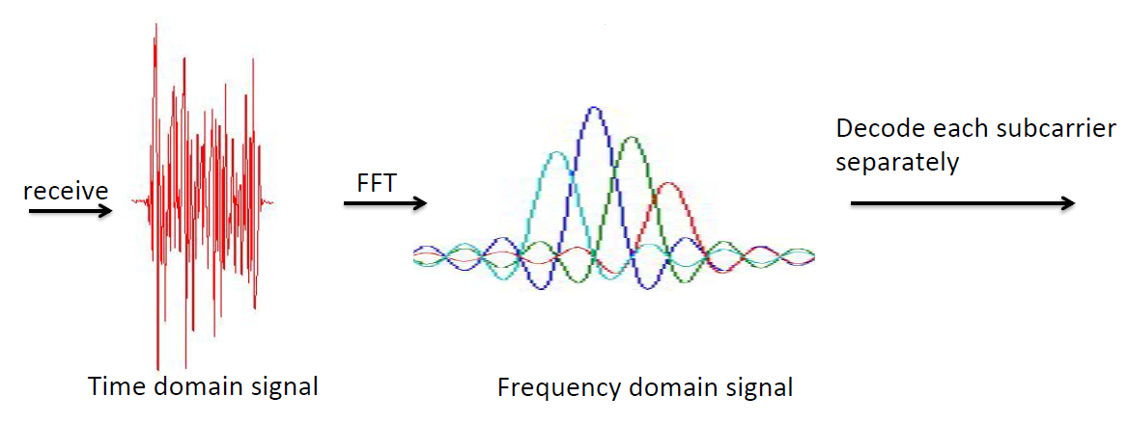
Frequency Domain vs Time Domain

Slide 22
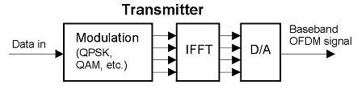
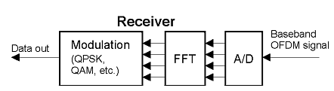
OFDM Transmitter and Receiver

Slide 23
OFDM Diagram
Transmitter
Modulation
Insert CP
S/P
IFFT
P/S
D/A
channel
+
noise
De-mod
remove CP
P/S
FFT
S/P
A/D
Receiver

Slide 24
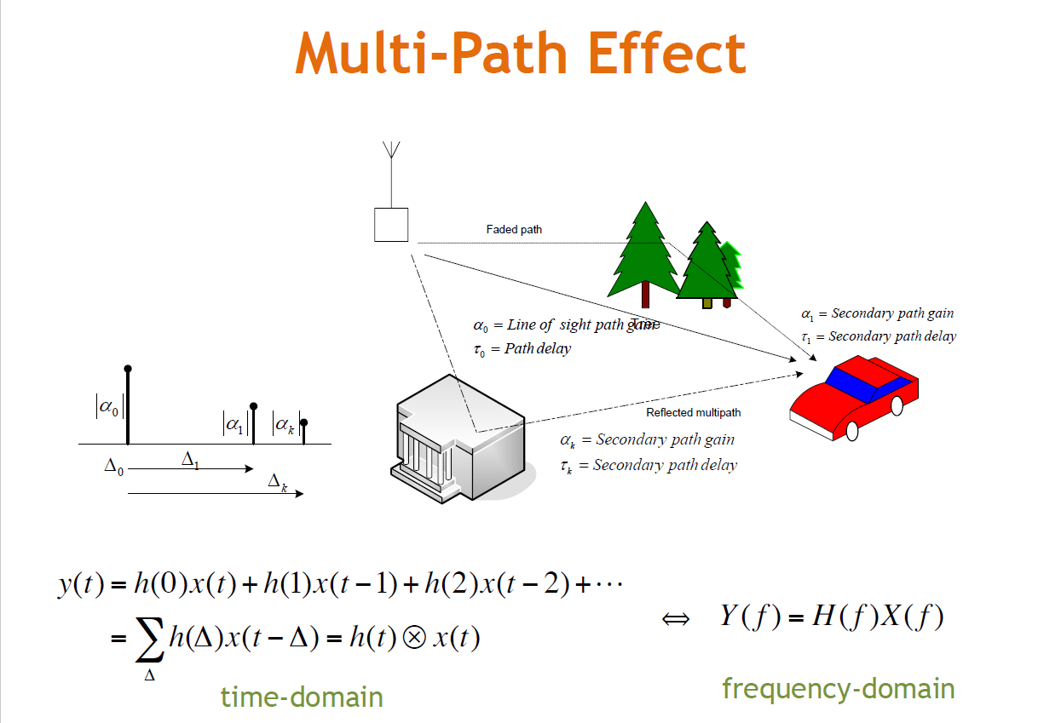

Slide 25
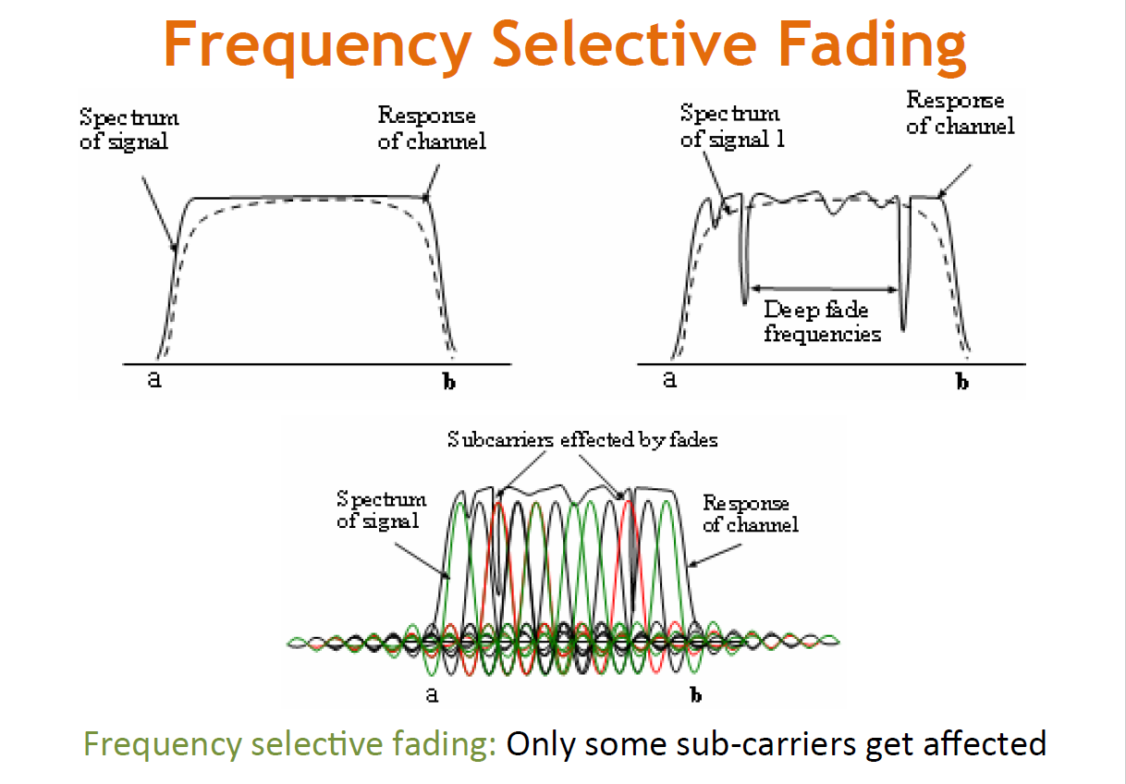

Slide 26
Inter Symbol Interference (ISI)
The delayed version of a symbol overlaps with the adjacent symbol
One simple solution to avoid this is to introduce a guard-band
Guard band

Slide 27
What is a cyclic prefix
The cyclic prefix provides a guard interval to eliminate inter-symbol interference from the previous symbol.
It repeats the end of the symbol so the linear convolution of a frequency-selective multipath channel can be modeled as circular convolution, which in turn may transform to the frequency domain via a discrete Fourier transform. This approach accommodates simple frequency domain processing, such as channel estimation and equalization.

Slide 28
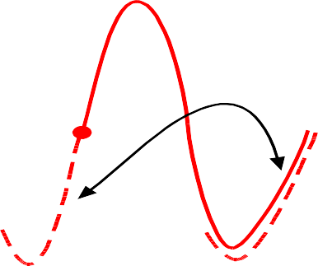
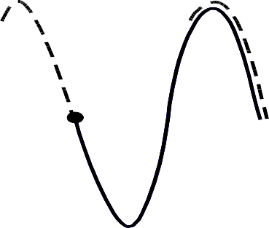
Cyclic Prefix (CP)
However, we don’t know the delay spread exactly
 The hardware doesn’t allow blank space because it needs to send out signals continuously
Solution: Cyclic Prefix
 Make the symbol period longer by copying the tail and glue it in the front
Symbol 2
Symbol 1 Copy this part at front
Copy this part at front
In 802.11,
CP:data = 1:4
Portion added in
the front
Original symbol
Extension
Original symbol

Slide 29
ISI effect of a multipath channel for each subcarrier

Slide 30
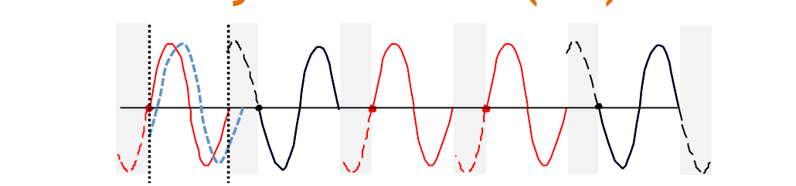
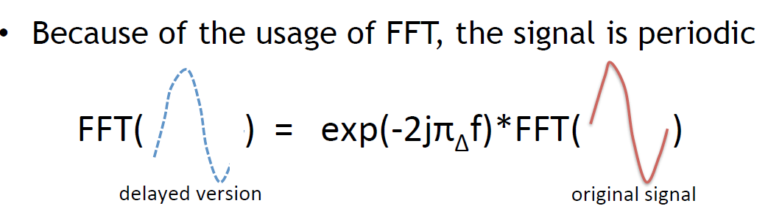
Cyclic Prefix (CP)
Delay in the time domain corresponds to
rotation in the frequency domain
Can still obtain the correct signal in the frequency domain by compensating this rotation

Slide 31
OFDM Modulation and Demodulation
The baseband OFDM signals in the continuous-time domain can be expressed respectively as

Slide 32
OFDM Communication

Slide 33
Advantages / Disadvantages
⚠️ Disadvantages
High PAPR (power amplifier stress)
Sensitive to frequency offset & Doppler
Requires precise synchronization
More complex baseband processing
✅ Advantages
Resilient to multipath fading
Simple frequency-domain equalization
High spectral efficiency
Supports adaptive modulation per subcarrier
Widely implemented using IFFT/FFT

Slide 34
Example-1
An OFDM system is designed with 2048 subcarriers over a total bandwidth of 40 MHz. To mitigate inter-symbol interference (ISI) caused by multipath propagation, a cyclic prefix (CP) is added before each OFDM symbol.
i) Determine the subcarrier spacing for this system.
ii) If the cyclic prefix duration is 1/16 of the useful symbol duration, calculate both the useful symbol duration and the total symbol duration (including CP).
iii) The wireless channel has a maximum delay spread of 4 µs. Evaluate whether the chosen cyclic prefix is sufficient to eliminate ISI completely. Justify your answer with appropriate calculations.
iv) Discuss how decreasing the total bandwidth (while keeping the number of subcarriers fixed) affects the OFDM system’s sensitivity to Doppler shift and frequency offsets.

Slide 35
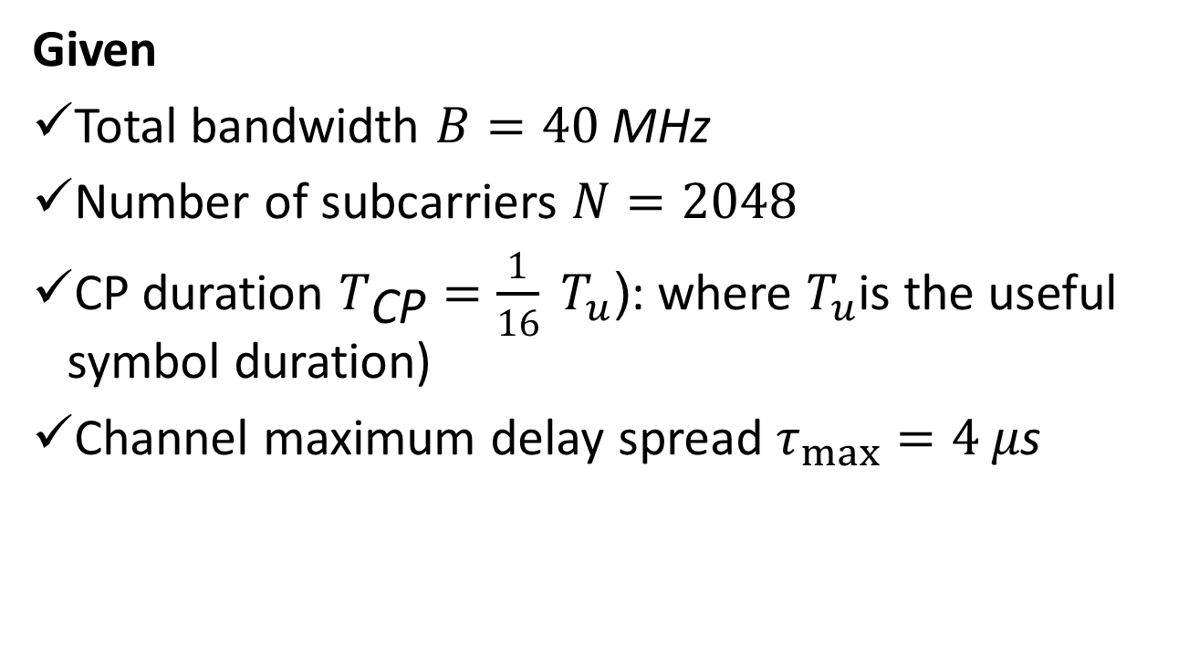
Solution
Given
Total bandwidth $B=40 \text{MHz}$
Number of subcarriers $N=2048$
CP duration $T_{\text{CP}}=\frac{1}{16} T_{u}$(: where $T_{u}$is the useful symbol duration)
Channel maximum delay spread $τ_{max}=4 μ\text{s}$

Slide 36
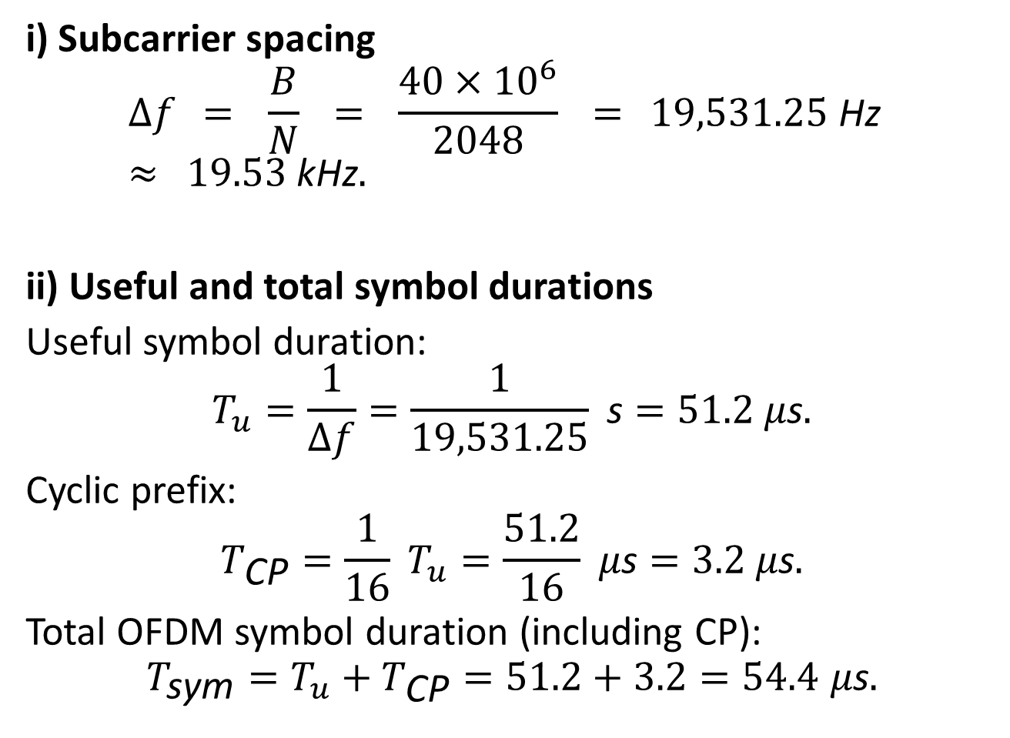
i) Subcarrier spacing
$$Δf = \frac{B}{N} = \frac{40×{10}^{6}}{2048} = 19,531.25 \text{Hz} ≈ 19.53 \text{kHz}.$$
ii) Useful and total symbol durations
Useful symbol duration:
$$T_{u}=\frac{1}{Δf}=\frac{1}{19,531.25} \text{s}=51.2 μ\text{s}.$$
Cyclic prefix:
$$T_{\text{CP}}=\frac{1}{16} T_{u}=\frac{51.2}{16} μ\text{s}=3.2 μ\text{s}.$$
Total OFDM symbol duration (including CP):
$$T_{\text{sym}}=T_{u}+T_{\text{CP}}=51.2+3.2=54.4 μ\text{s}.$$

Slide 37
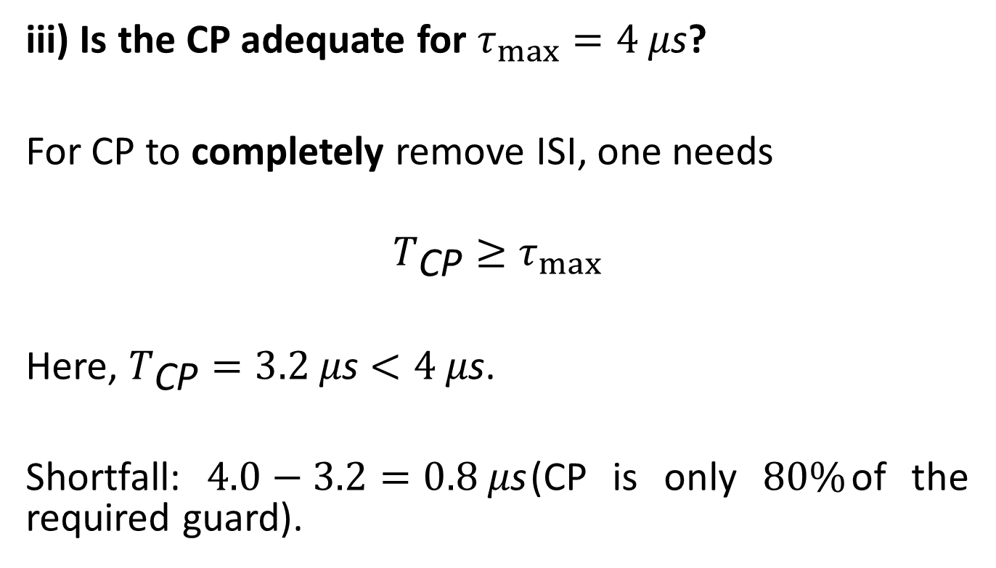
iii) Is the CP adequate for $τ_{max}=4 μ\text{s}$?
For CP to completely remove ISI, one needs
$$T_{\text{CP}}≥τ_{max}$$
Here, $T_{\text{CP}}=3.2 μ\text{s}<4 μ\text{s}$.
Shortfall: $4.0−3.2=0.8 μ\text{s}$(CP is only $80\%$of the required guard).
No, the chosen CP is not sufficient to completely remove ISI.

Slide 38
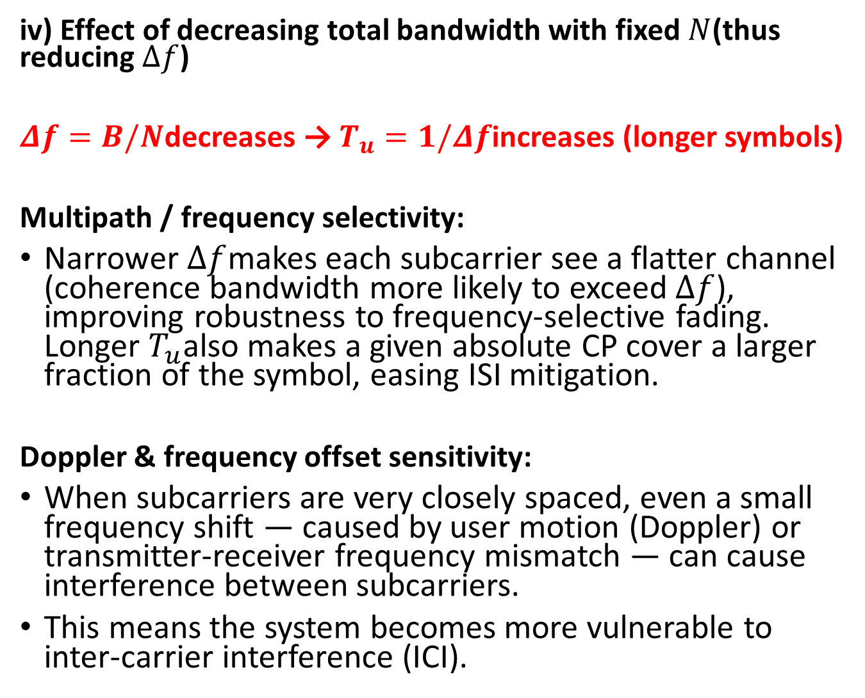
iv) Effect of decreasing total bandwidth with fixed $N$(thus reducing $Δf$)
$Δf=B/N$decreases → $T_{u}=1/Δf$increases (longer symbols)
Multipath / frequency selectivity:
Narrower $Δf$makes each subcarrier see a flatter channel (coherence bandwidth more likely to exceed $Δf$), improving robustness to frequency-selective fading. Longer $T_{u}$also makes a given absolute CP cover a larger fraction of the symbol, easing ISI mitigation.
Doppler & frequency offset sensitivity:
When subcarriers are very closely spaced, even a small frequency shift — caused by user motion (Doppler) or transmitter-receiver frequency mismatch — can cause interference between subcarriers.
This means the system becomes more vulnerable to inter-carrier interference (ICI).

Slide 39
Example-2
An OFDM system employs 1024 subcarriers across a total bandwidth of 25 MHz.
i) Determine the subcarrier spacing.
ii) If the cyclic prefix (CP) duration is 20% of the useful symbol duration, calculate the total OFDM symbol duration including CP.
iii) The wireless channel exhibits a maximum delay spread of 3 µs. Evaluate whether the selected CP duration is adequate to prevent inter-symbol interference (ISI). Justify mathematically.
iv) Briefly state one key advantage and one key drawback of using a higher number of subcarriers in an OFDM system.

Slide 40
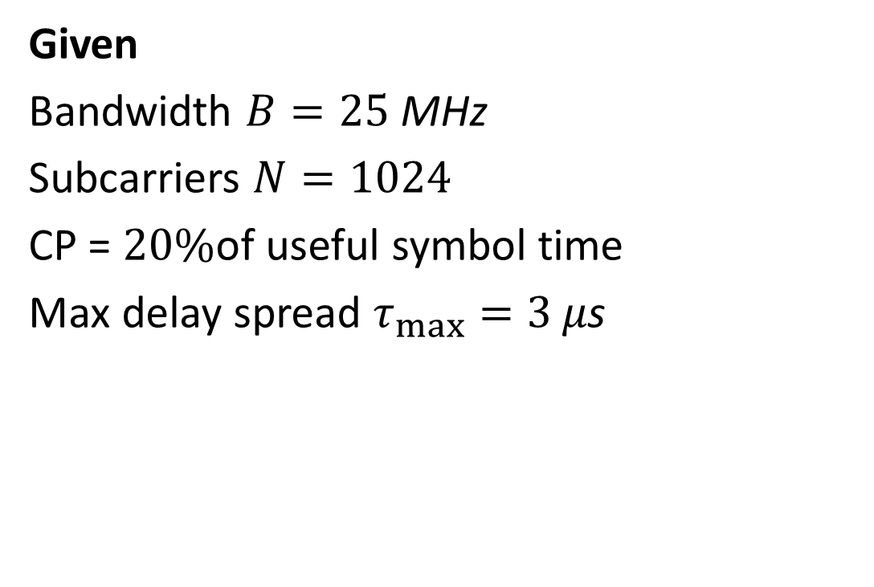
Given
Bandwidth $B=25 \text{MHz}$
Subcarriers $N=1024$
CP = $20\%$of useful symbol time
Max delay spread $τ_{max}=3 μ\text{s}$

Slide 41
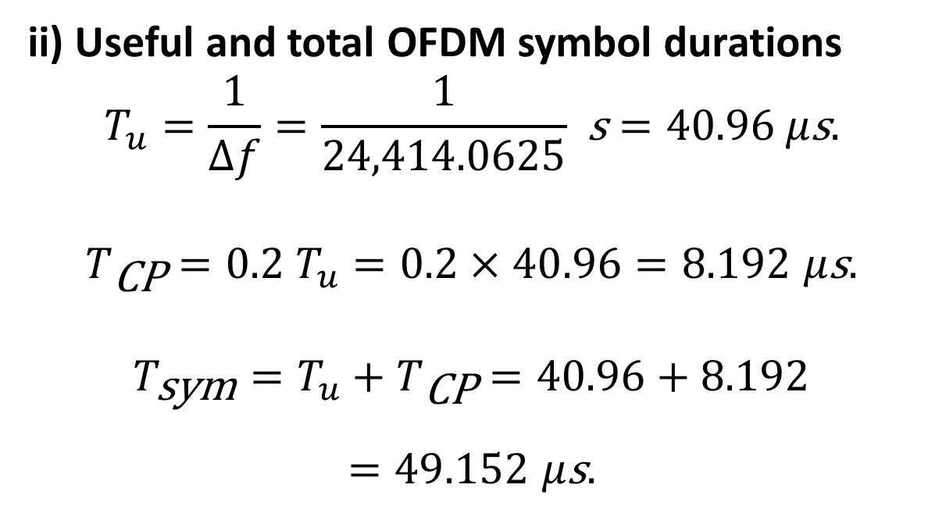
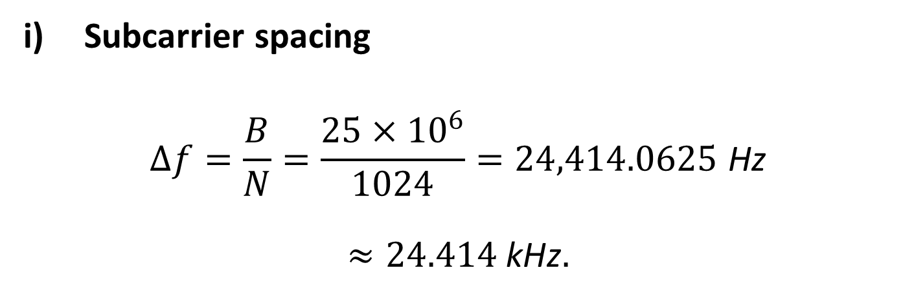
Subcarrier spacing
$$Δf=\frac{B}{N}=\frac{25×{10}^{6}}{1024}=24,414.0625 \text{Hz}$$
$$≈24.414 \text{kHz}.$$
ii) Useful and total OFDM symbol durations
$$T_{u}=\frac{1}{Δf}=\frac{1}{24,414.0625} \text{s}=40.96 μ\text{s}.$$
$$T_{\text{CP}}=0.2 T_{u}=0.2×40.96=8.192 μ\text{s}.$$
$$T_{\text{sym}}=T_{u}+T_{\text{CP}}=40.96+8.192$$
$$=49.152 μ\text{s}.$$

Slide 42
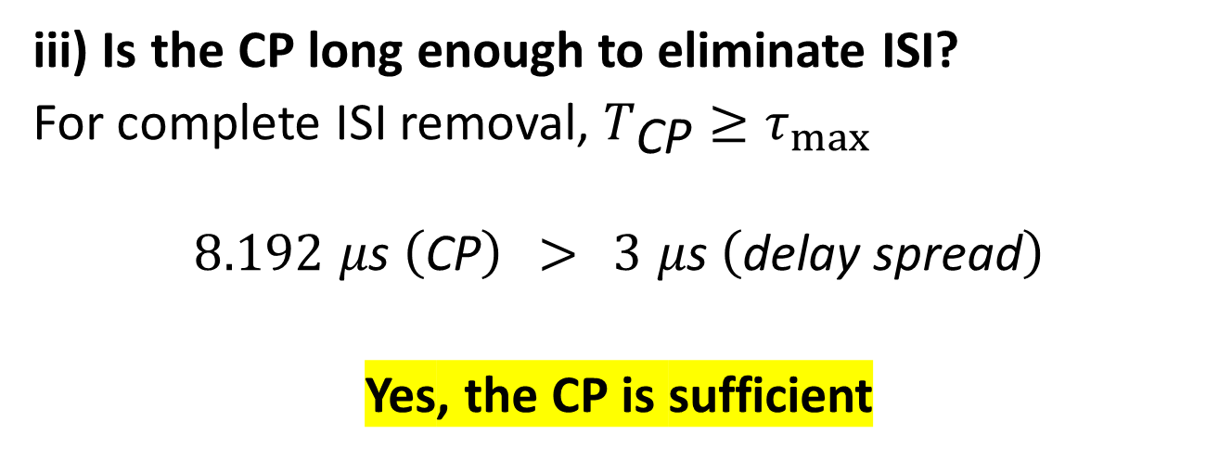
iii) Is the CP long enough to eliminate ISI?
For complete ISI removal, $T_{\text{CP}}≥τ_{max}$
$$8.192 μ\text{s} \left(\text{CP}\right) > 3 μ\text{s} \left(\text{delay} \text{spread}\right)$$
Yes, the CP is sufficient
iv) Main trade-off of increasing subcarrier count
Advantage: Narrower subcarriers and longer symbols make each subcarrier see a flatter channel, improving robustness to frequency-selective multipath and reducing ISI (for a given absolute CP).
Drawback: The system becomes more sensitive to Doppler and frequency-offset (more ICI) and also suffers higher PAPR and FFT complexity.

Slide 43
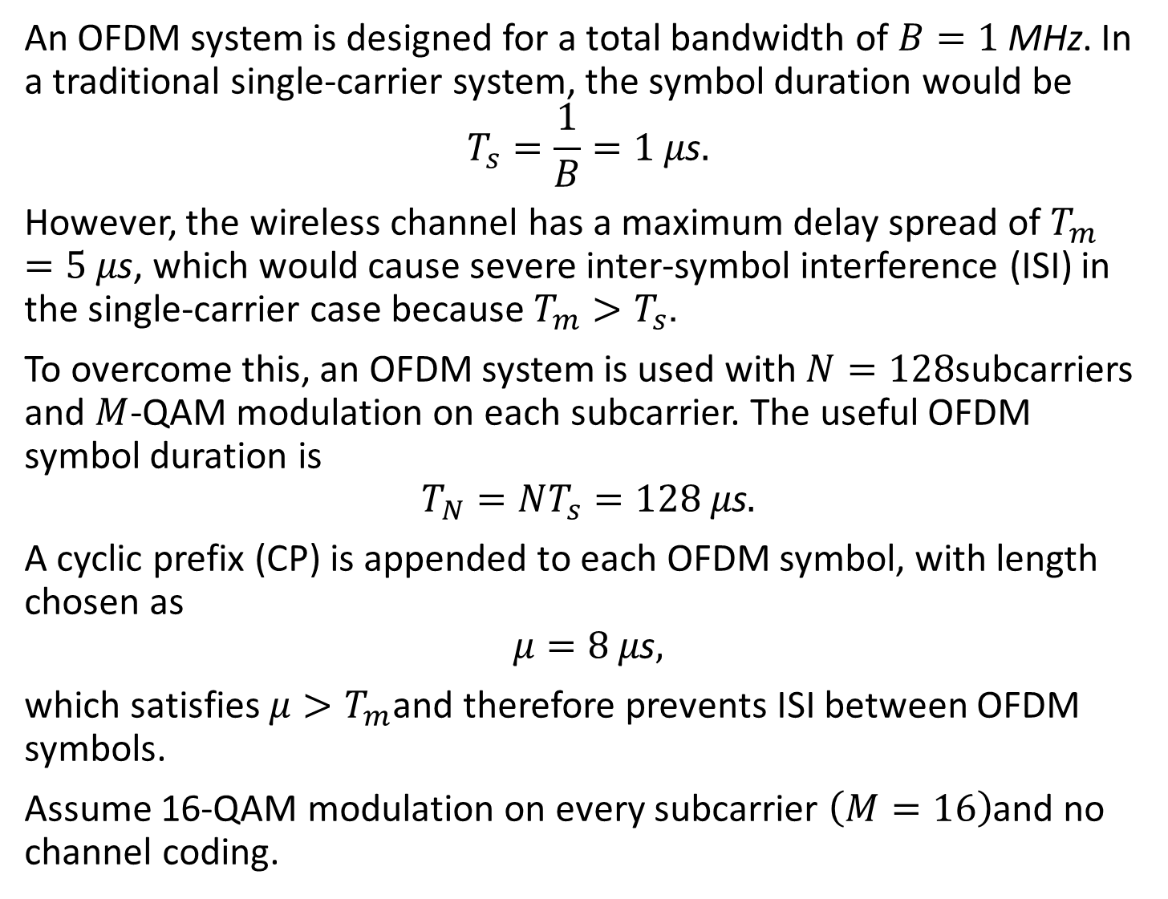
Example(Homework)
An OFDM system is designed for a total bandwidth of $B=1 \text{MHz}$. In a traditional single-carrier system, the symbol duration would be
$$T_{s}=\frac{1}{B}=1 μ\text{s}.$$
However, the wireless channel has a maximum delay spread of $T_{m}=5 μ\text{s}$, which would cause severe inter-symbol interference (ISI) in the single-carrier case because $T_{m}>T_{s}$.
To overcome this, an OFDM system is used with $N=128$subcarriers and $M$-QAM modulation on each subcarrier. The useful OFDM symbol duration is
$$T_{N}=NT_{s}=128 μ\text{s}.$$
A cyclic prefix (CP) is appended to each OFDM symbol, with length chosen as
$$μ=8 μ\text{s},$$
which satisfies $μ>T_{m}$and therefore prevents ISI between OFDM symbols.
Assume 16-QAM modulation on every subcarrier $\left(M=16\right)$and no channel coding.

Slide 44
Tasks
Compute the bandwidth of each OFDM subcarrier.
Determine the total duration of one OFDM symbol, including the cyclic prefix.
Calculate the overhead percentage introduced by the cyclic prefix.
Find the data rate of the system, assuming all subcarriers carry data (no pilots, no nulls).

Slide 45
Answers
Subcarrier bandwidth | 7.8125 kHz
Total OFDM symbol time (incl. CP) | 136 µs
CP overhead | ≈ 5.9%
Data rate (16-QAM, no coding) | ≈ 3.76 Mbps

Slide 46
Real-World Uses of OFDM
Technology | Bandwidth | Subcarriers
Wi-Fi 802.11a/g/n/ac/ax | 20–160 MHz | 64–234 subcarriers
LTE Downlink | 1.4–20 MHz | 128–2048 FFT
5G NR | Up to 400 MHz | 4096+
DVB-T | 8 MHz | 2048 or 8192
ADSL/VDSL | 1.1 MHz | 256 or 512

Slide 47
Questions
Why is OFDM preferred in Wi-Fi instead of single-carrier QAM?
What happens if CP < delay spread?
Why does increasing subcarriers increase Doppler sensitivity?
How would OFDM behave in high-speed trains (>300 km/h)?

Slide 48
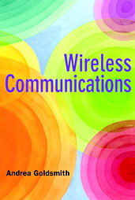
Reference book
For more information on OFDM:
Andrea Goldsmith, “Wireless Communications”, Cambridge University Press, 2005
Chapter 12: Multicarrier Modulation (pp. 374-402)

